Slide 1
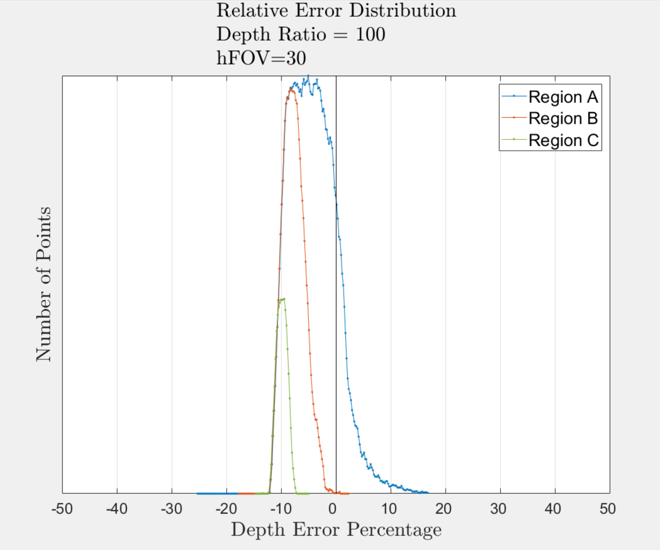
Region A:
Region B:
Region C:
Northing
Easting

Slide 2
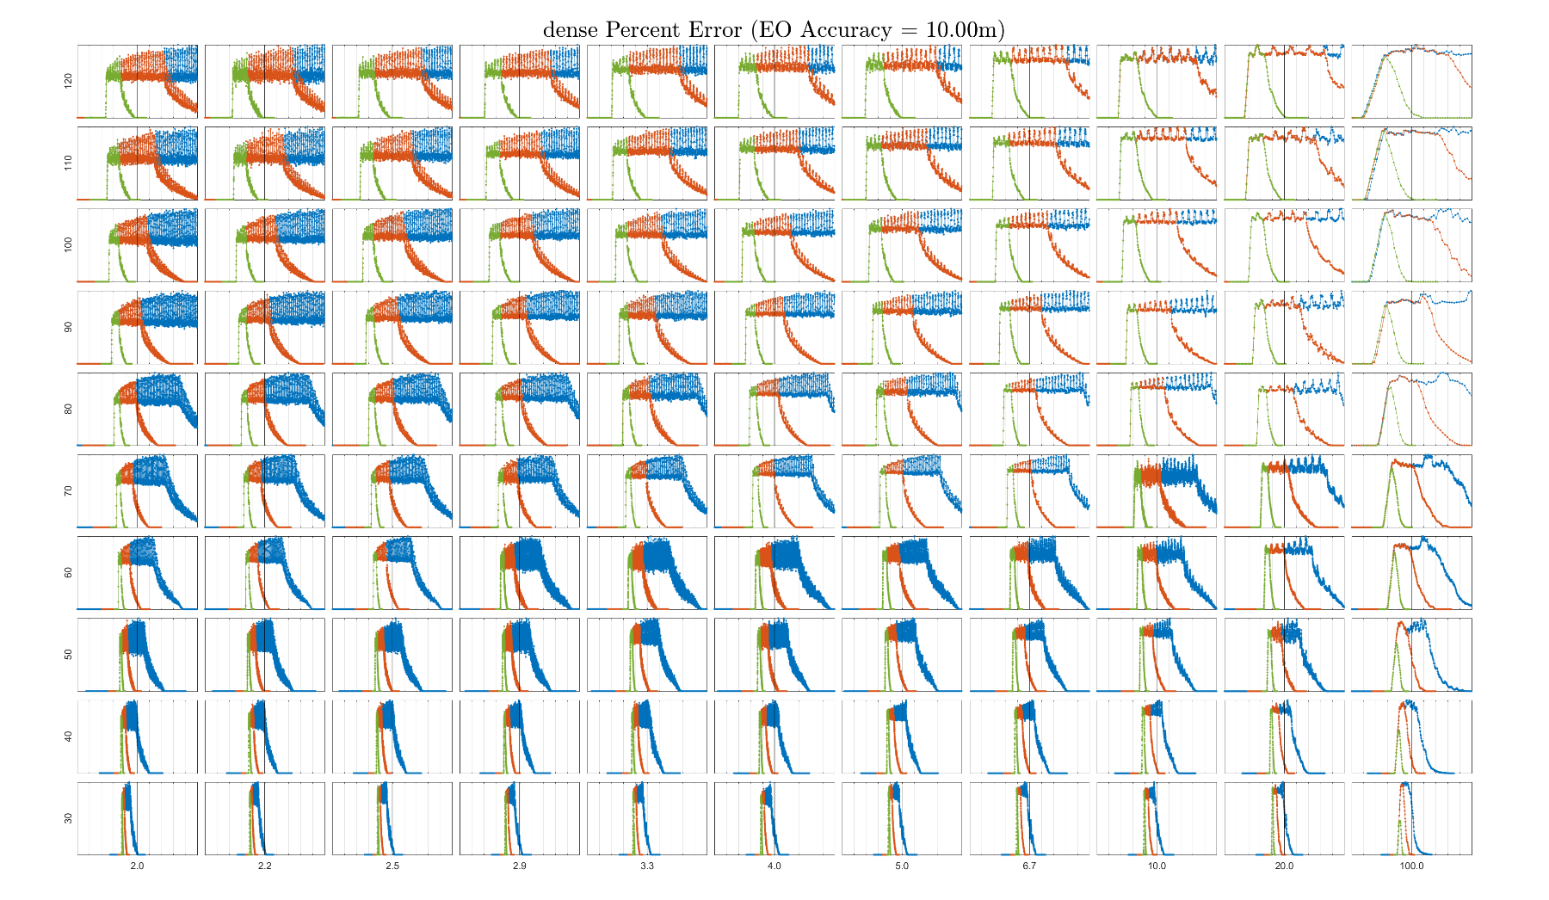
These Change
Better (More Narrow hFOV)
Horizontal Field of View
Better (Less water at same altitude)
Air:Water Ratio

Slide 3
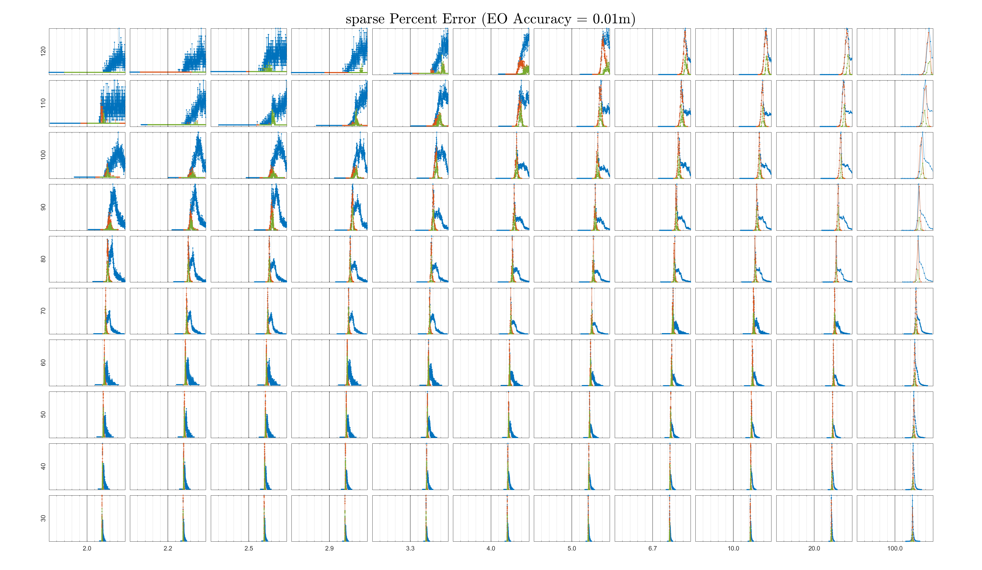

Slide 4
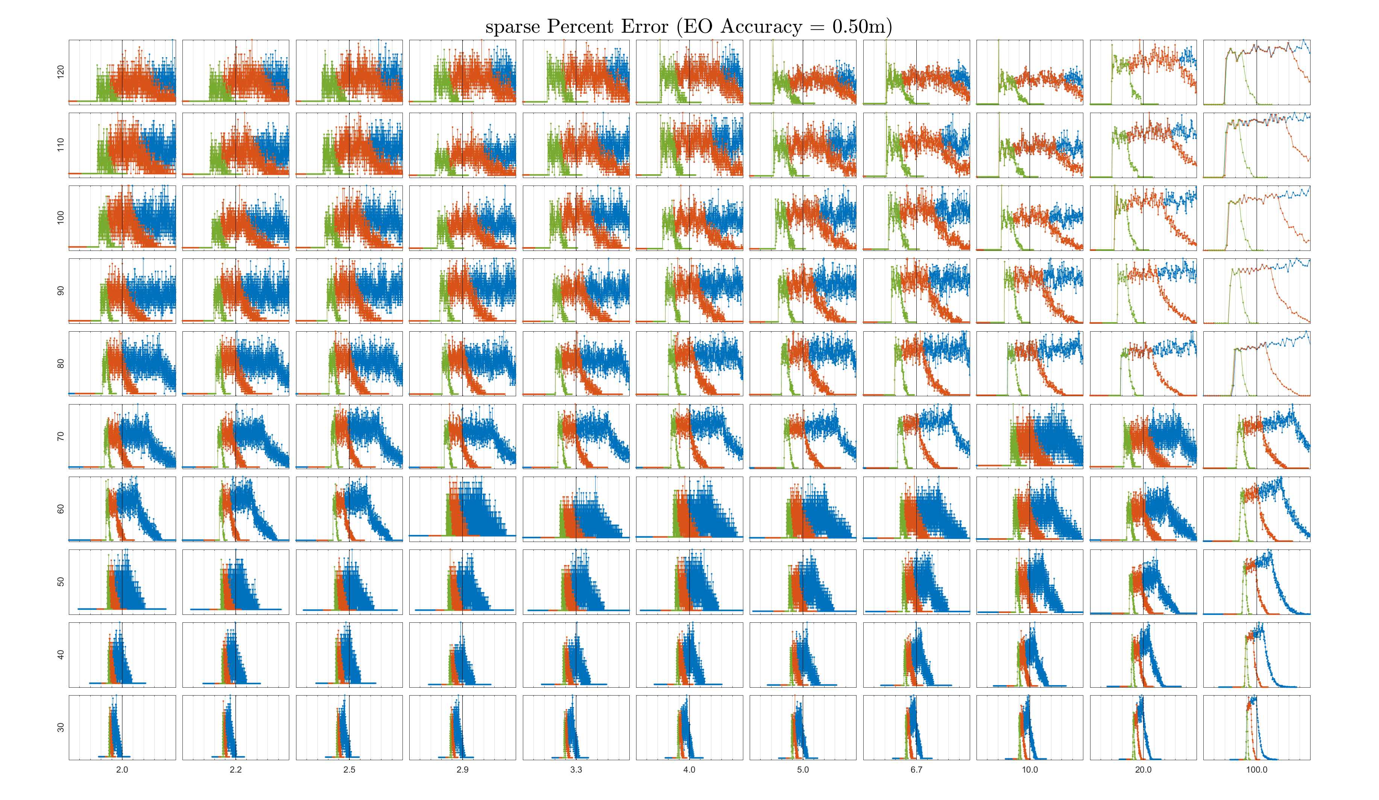

Slide 5
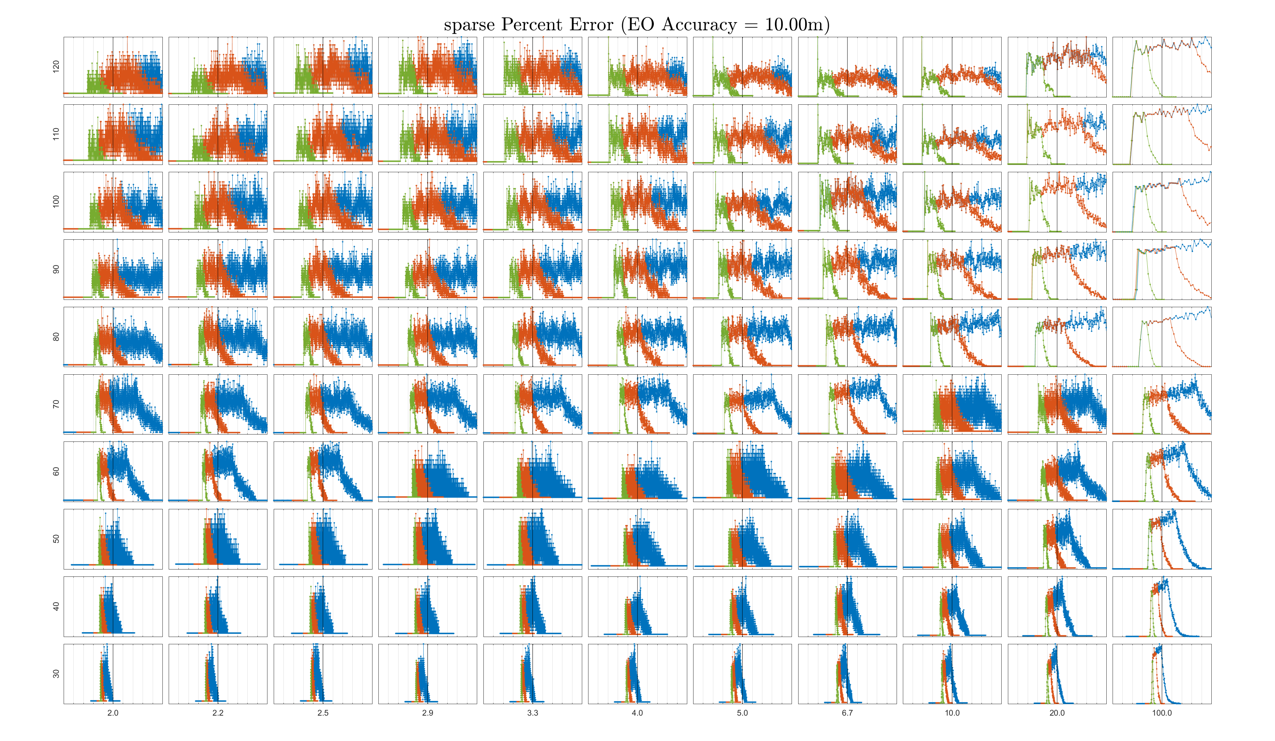

Slide 6
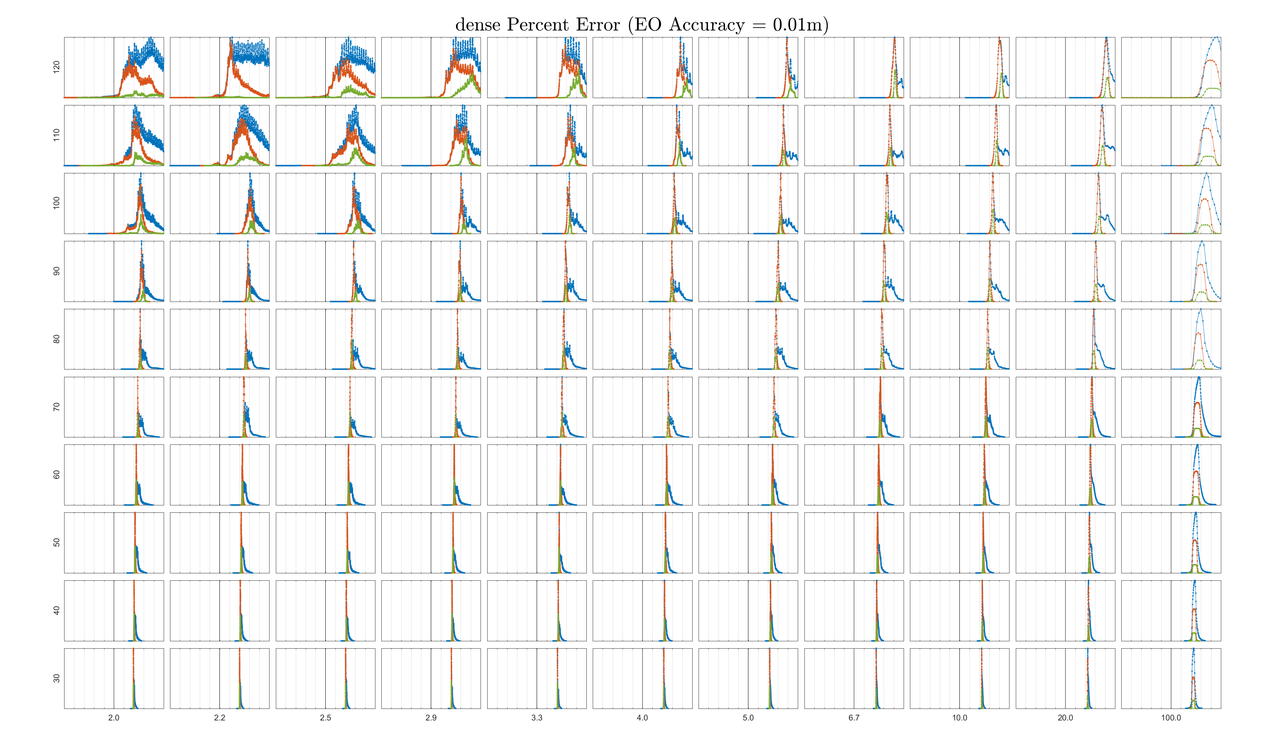

Slide 7
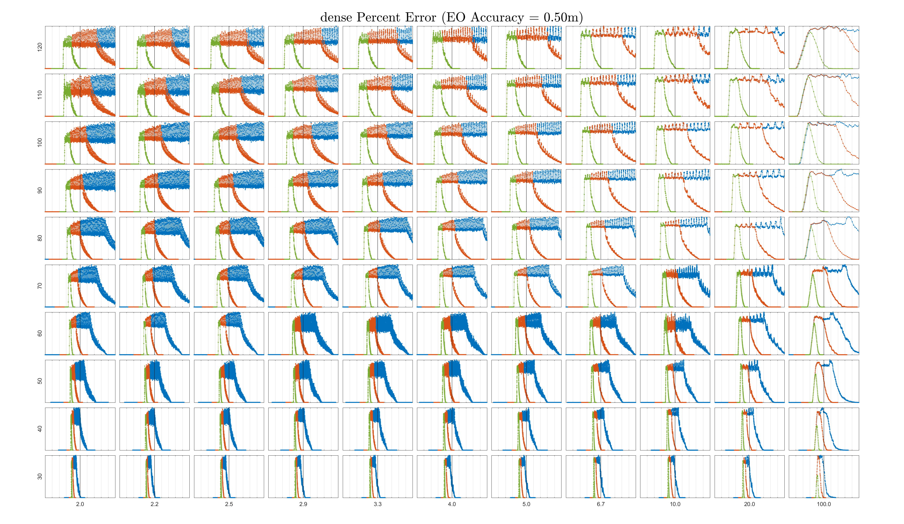

Slide 8
